Slide 1

Evaluation Influence: A Mere Semantic Point or Conceptual Revolution?
James Herbert
PhD Candidate in the School of Social Sciences
University of Western Sydney

Slide 2

Evaluation Influence: A Mere Semantic Point or Conceptual Revolution?
Influence has been suggested as a remedy to a number of issues identified with evaluation use.
Influence is a conceptual framework that has potential to add to understanding about how and why evaluations effect change.
While applied as a research approach in some studies, influence still lacks authority as a body of evidence to inform evaluation practice.
The approach still has promise, but needs direction.

Slide 3
Utilisation
Impact
Use
Symbolic Use
Conceptual Use
Influence
Effect
Results Use
Process Use
Imposed Use
Instrumental Use

Slide 4
Why Study the Effect an Evaluation Has?
Evaluation impact assessments.
Planning evaluations around maximising or specific types of effects.
Designing programs and organisations around best practice in the use of evaluation information

Slide 5
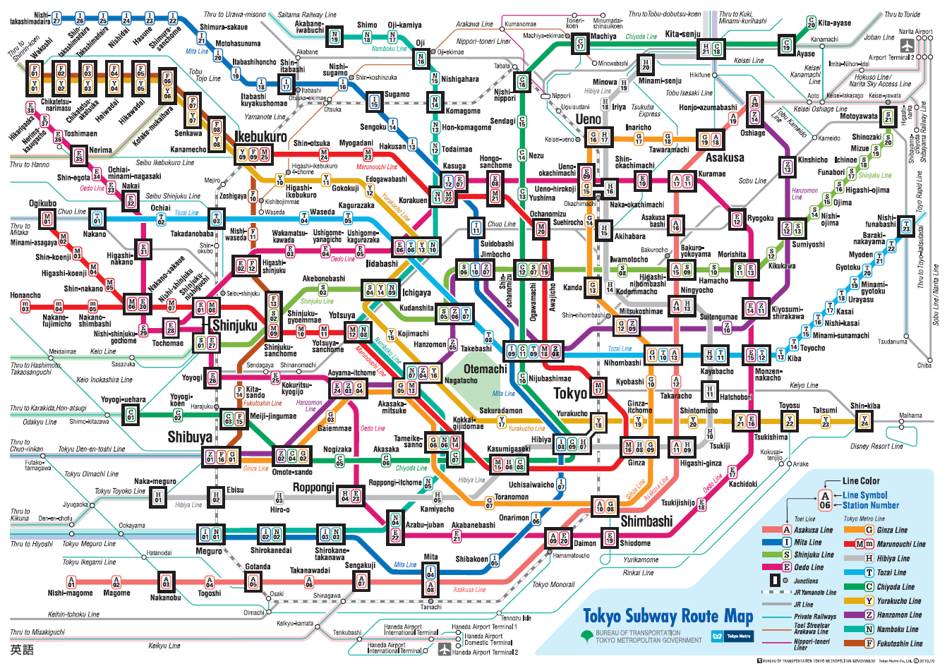
Minowa to Shinjuku

Slide 6
The Case for Influence
Definition reflects the full impact of an evaluation.
Systematic framework to consider specific mechanisms of change.
The study of pathways of influence, including where evaluation fails to affect change.
Moral imperative to affect social betterment.

Slide 7
Influence as a Theory of Effect
Henry & Mark (2003)
Individual
Kirkhart (2000)
Alkin & Taut (2003)
Attitude Change
Mark & Henry (2004)
Salience
Elaboration
Priming
Intention
Intention
Skill Acquisition
Level of Analysis
Unintended
Intended
Unaware Unintended
Aware Unintended
Behavioral Change
Interpersonal
Individual
Aware Intended
Justification
Interpersonal
Persuasion
Collective
Source
Source
Change Agent
Process
Result
Process
Result
Social Norms
Type of Process/Outcome
Minority-Opinion Influence
Collective
General Influence
Time
Time
Agenda Setting
Cognitive and Affective
Immediate
End-Of-Cycle
Immediate
End-Of-Cycle
Policy Oriented Learning
Motivational
Long-Term
Long-Term
Policy Change
Behavioral
Diffusion

Slide 8
Influence as a Theory of Effect
Alkin and Taut’s (2003, p. 9) model detailing the distinction between use and influence (adapted from Kirkhart, 2000)

Slide 9
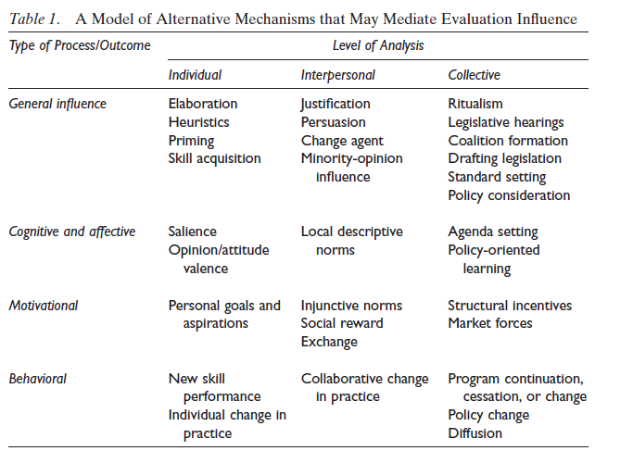
Influence as a Theory of Effect
Mark and Henry’s (2004, p. 41) model of evaluation influence.

Slide 10
Influence as a Theory of Effect
Mark and Henry’s (2004, p. 46) model of evaluation influence.

Slide 11
Applying Influence – Case Studies
  Influence by Scope – Alexander (2003); Allen (2010); Cooksy & Caracelli (2005); Frey (2010); Morabito (2002); Poth (2008); Vanlandingham (2011); Weets (2008).
  Influence by Definition – Bamberger (2004); Frey & Widmer (2011); Henry (2003); McEathron (2008).
  Kirkhart – Benjamin & Misra (2006); Burr (2009); Rebolloso, Balthasar, & Canton (2005).
  Henry & Mark – Cheng (2006); Cowley & Good (2010); Diaz-Puente, Yague, & Afonso (2008); Diaz-Puente, Montero, & Carmenado (2009); Fjellstrom (2007); Lehtonen (2010); Oliver (2008); Weiss et al. (2005).

Slide 12
Applying Influence in Researching the Effect of Evaluation
Surveys of Influence
  Burr (2009); Christie (2007); Swanson & Barlage (2006).
Citation Analysis
  Greenseid (2008); Greenseid, Johnson, & Lawrenz (2008); Swanson & Barlage (2006)

Slide 13
How Robust is the Literature?
Research on influence by evaluators themselves?
Variations in methodological quality.
Reliance on self-report.
Timing of periods of observation.
‘Intertangling’ of threads of influence.

Slide 14
What Does It Mean for Evaluation Practice
Consolidate existing literature.
  Consistent definitions and research procedures.
  Analysis of the viability of influence as a research approach
  Integration of knowledge from the use literature
Development of a research agenda.
Continued reflection on what influence means for practice.

Slide 15
Questions?
A full list of references are available in my conference paper
James Herbert
School of Social Sciences
University of Western Sydney
j.herbert@uws.edu.au

